Slide 1

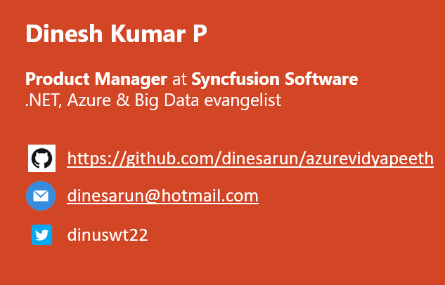
Is Big Data Hyped?
Lets talk the Ecosystem, Cloud & more…
Notes:
Good evening guys. I am Dinesh Kumar. Product Manager at Syncfusion Software. I role play as a Growth Hacker in Data Platform team. And I am pretty happy to present this session to you all.
Earlier the concentration was more on big data storage and processing. Now it turned towards machine learning and artificial intelligence. So the thought process has changed from storage towards analytics. Which you can see the examples as products evolvement itself.
Cloudera and Hortonworks merged together. Apart from MapR in next position there is no big vendor in market as far as I know.
A lot of tools, products come into market everyday related to Analytics i.e. Machine Learning and AI which doesn’t peek in about Storage and Processing much but mean about the value and insights we get. Because Storage and Processing is all that Cloud takes care of. (Processing I mean here is cleansing, ETL and so).
Include points from Amazon’s web page blog about “What is Big Data?”

Slide 2
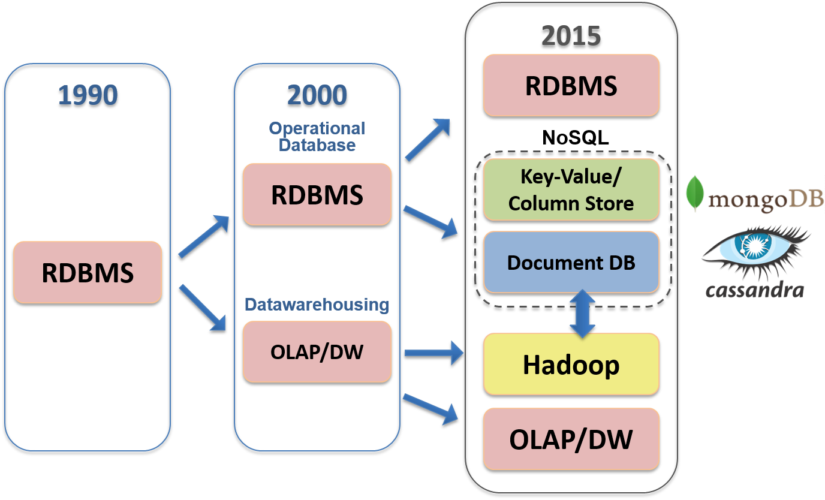
Notes:
I hope all of you would have worked in one or more of these sectors of data storage frameworks

Slide 3
Agenda
Data Scientist
Data Analyst
ML Engineer
Data Admin
Data Engineer
Notes:
We will be having today’s session as stories that revolves around these work roles. Because “Big Data” - is not a technology or Software, its THINKING.

Slide 4
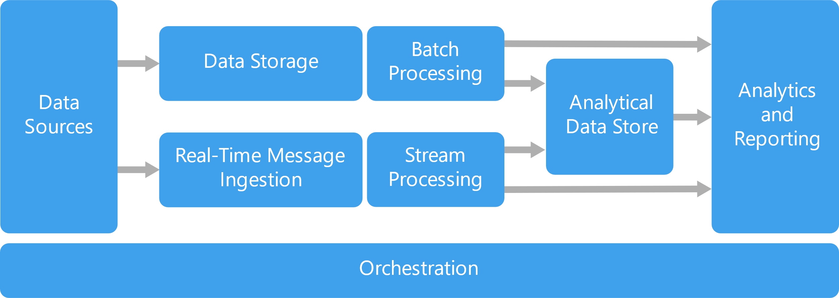
Notes:
Processes involved in a typical data project or any projects that ends with delivering something for decision making.

Slide 5
Data Engineers
Which raw data to use? - Almost all.
What kind of environment should I setup? – More of Big Data Admin.
How raw data be processed to create prepared data? – More of Big Data Developer.
Identify Combinations of prepared data and machine learning algorithms should you use to create the best model? – More of Data Scientist.
All these analysis as dashboard / report for decision making. – More of BI specialist.
Notes:
Inspite we are not called as Data engineers, we will be coming across any of these questions at some point of our work.

Slide 6

Domains, Industries
Marketing
Sales and CRM
Web Analytics
Ecommerce
Advertising
IT
Finance
Healthcare
Social Media
SEO
Banking
Human Resources
Mobile Analytics
Project Management
Research and Development
Support
Survey
Insurance
Manufacturing
Energy
Oil & Gas
Pharmaceuticals
Retail
Communications
Food and Beverages
Education
Media
Transportation and Logistics
Notes:
Different domains now a days produces different KINDS of data. Upon which all cannot be fit into traditional SQL based database systems for storage or processing or analyzing.

Slide 7
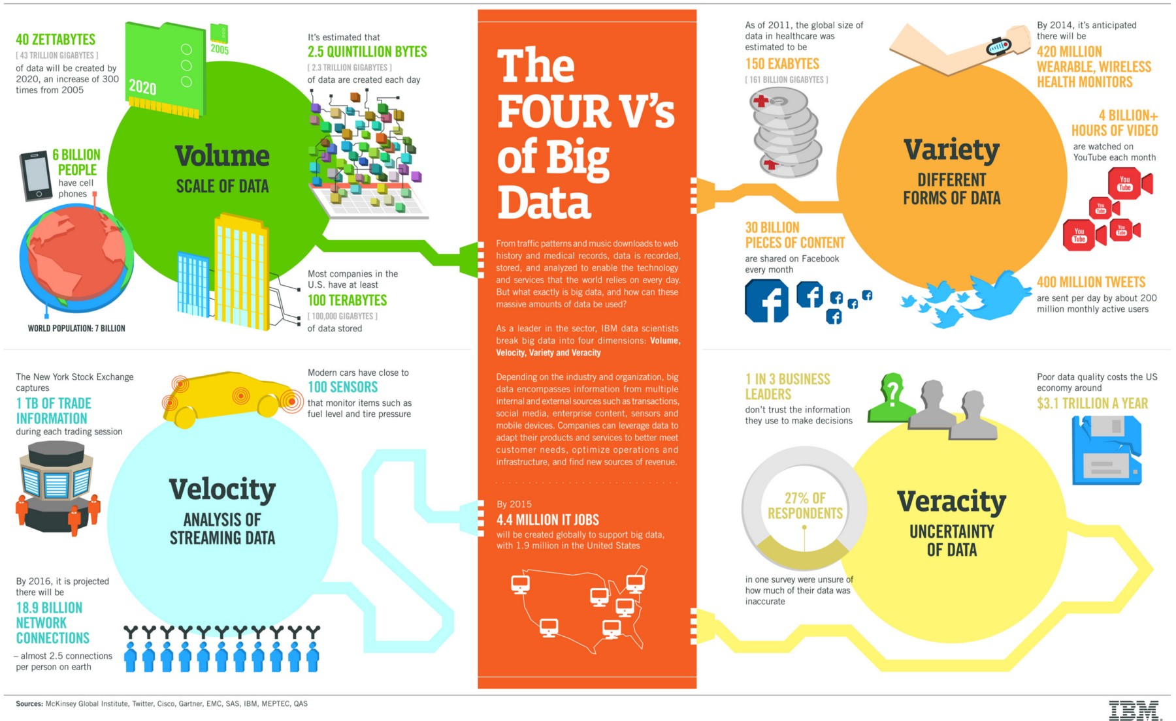
Notes:
Big data is everywhere—the volume, variety, and velocity of data make advanced, rapid analysis a priority.
(Include valid points from Amazon’s web page)

Slide 8
Why BigData? SQL Comparison
Hadoop (Big Data storage) | SQL
Schema on Read | Schema on Write
Data stored as Compressed form as txt / csv or any form. | Stored as logical forms and inter related columns
Distributed processing across commodity hardware. | Centralized processing over high-end hardware.

Slide 9
Why Big Data?
Open source analogy (Cost).
Enriched with rich ecosystem to be played with,
SQL, No SQL..
Cloud, On-Premises..
Base for almost all Analytics (AI, ML) use-cases.
At the early 2012 – it’s a big fame too ☺.
Notes:
Cost reduction - Big data technologies such as Hadoop and cloud-based analytics bring significant cost advantages when it comes to storing large amounts of data.

Slide 10
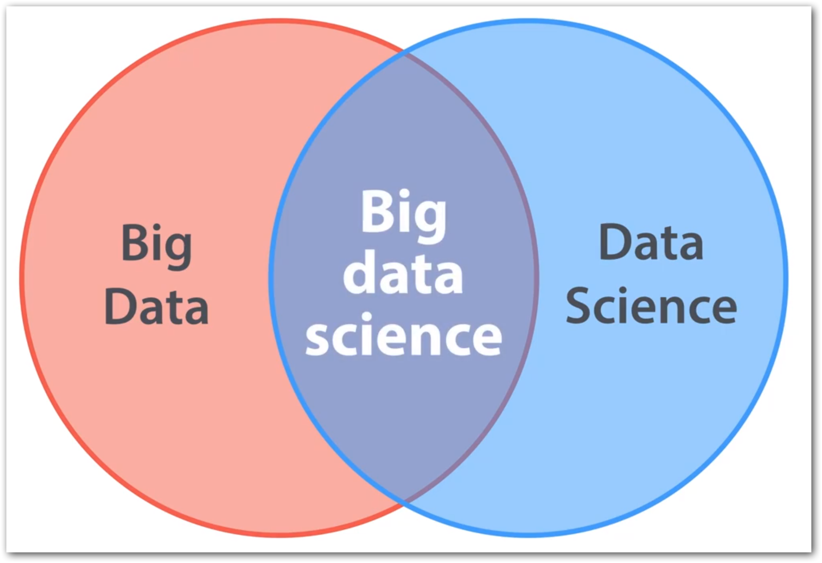
Big Data vs Data Science
Big Data + Data Science = Big Data Science.
Big Data ≠ Data Science
Big Data <- All 4 Vs;
E.g. Shares trading, E-Shopping
Data Science <- 1 or 2 Vs;
E.g. ML use cases like Genetics data, Credit card fraud detection – Volume
Notes:
Frequent confusion among us.

Slide 11
Data engineer’s routine work (Loop again)
2. Identify source(s) of Data
4. Storage & Access
5. Processing
6. Visualization
3. Data Integration
1. Defining Objective

Slide 12

Use case
An insurance firm.
Grown over the years through acquisition of many small insurance companies - hence, it doesn’t have a single, consolidated view of their customer base.
Also details are fragmented among many subsystems, product lines -
Health insurance,
Vehicle insurance,
Pet insurance, etc.
So plans to build a data lake.
Data scientists or BI analysts to generate insights.
From: https://www.thoughtworks.com/insights/blog/curse-data-lake-monster
Notes:
Different file formats.
Different reporting tools.
Different data types – Phone calls, Logs, Feedbacks.

Slide 13

1. Defining Objective
Understand the domain & industry,
Discuss about the business need / problem,
Ask more and more WHYs?
Prepare the objectives.

Slide 14
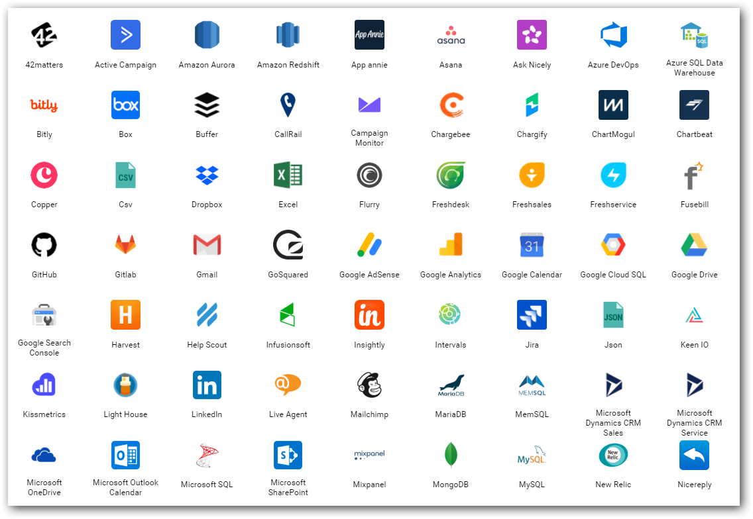
2. Data source(s)
Find out from where you need to get the data for your project.
Either provided or should search and find.
Logs
Databases
Web (REST APIs)
Social Media
…
Notes:
Logs – NASA logs which we gonna process.

Slide 15
3. Data Integration
Required data would exist in different sources those need to be brought to one place for,
Gather
Clean
Prepare
Tools
Apache Sqoop
Azure Data Factory
Informatica
Apache Nifi…
Apache Kafka

Slide 16
4. Storage & Access
Different stages
Initial
Processing
Final
Instances & Services
Cloud Database instances (SQL Server, MySQL,..)
Azure Data Lake…
Access with Security on top
Extra measures to protect unstructured data
API easy to integration between processing tools

Slide 17
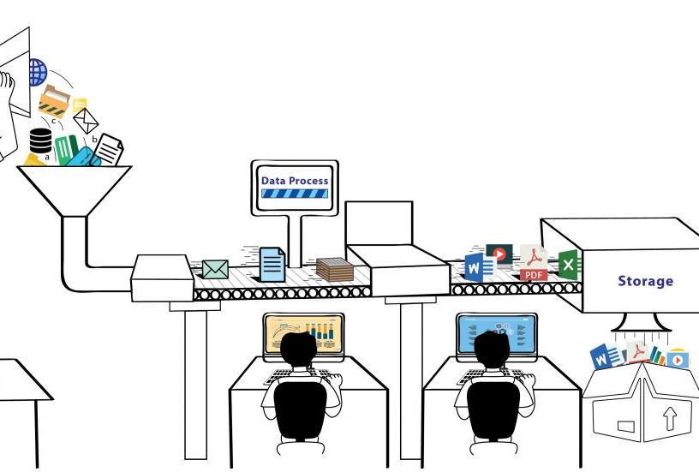
5. Process
Analyze / Do Analytics
ML models
Map Reduce
Tools & Services
Apache Pig
Azure HDInsight
Azure Databricks (Spark)
Azure ML Studio
ML .Net

Slide 18
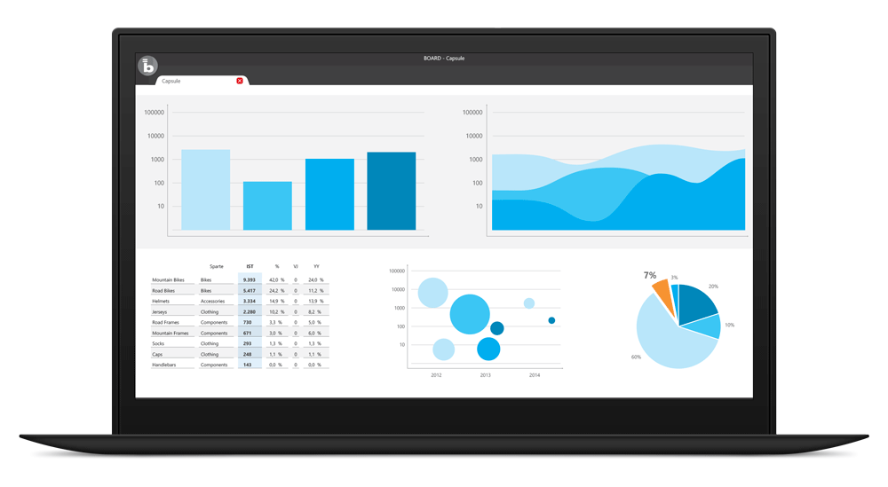
6. Visualize
BI tools for business decisions
Microsoft Power BI
Tableau
Qlik
Bold BI
…
In-built packages in R, Python

Slide 19
Big Data hype…
Companies were selling Big Data solutions as a silver bullet solution to all the enterprises’ problems.
Use case using Hive+Oozie turned with MySQL+Cron.
There was no ideal approach like below;
Client - “I want to implement a Big Data solution”
Consultant- “That could be the solution, but let us discuss the problem first”.
Notes:
My opinion - Ecosystem projects are not growing to be compatible with Hadoop. E.g. Pig, Sqoop, Oozie,…

Slide 20
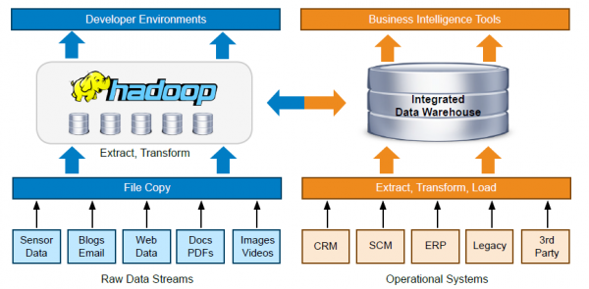
Notes:
Orchestration of the entire process. ML Ops

Slide 21

Big Data in Cloud
Dynamic scalability - Go with perfectly sized cluster(environment) only when needed.
Key vendors,
Microsoft Azure,
Amazon Web Services,
Google Cloud Platform
Cloud database options

Slide 22
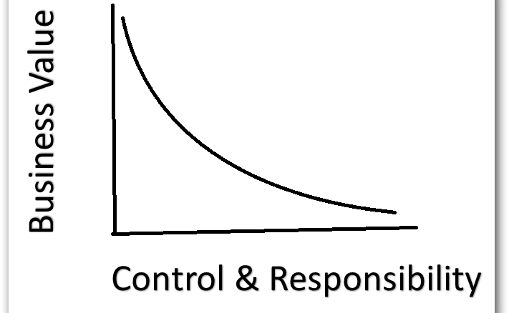
Control & Responsibility over Business Value
Simple analogy,
Build a car?
Buy a car?
Rent a car?
Notes:
DevOps analogy - Fail quickly. Prove ROI. Then Scale yourself.

Slide 23
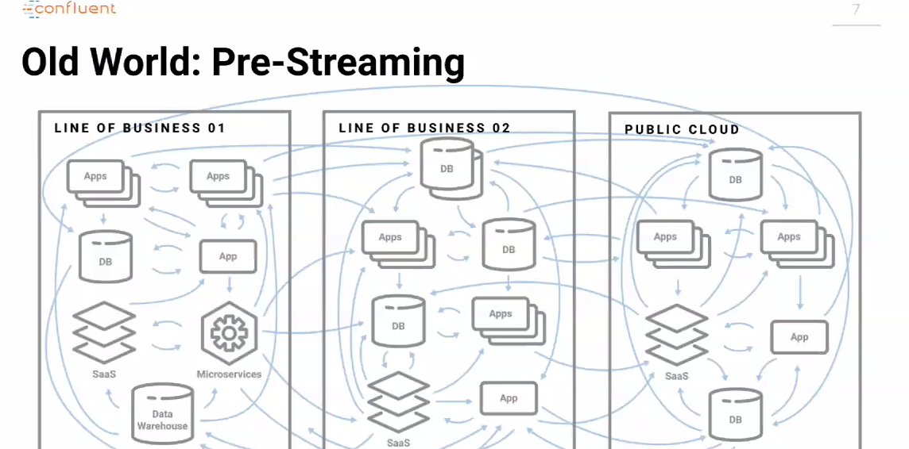
Notes:
Integration is a major hurdle—especially as data comes in from multiple sources, departments, and geographies.

Slide 24
Kafka and Spark
Streaming platform’s necessity.
Hadoop made fast. So decision-making as well.
Notes:
Expectations are sky-high—for both using data to capture new insights and unlock efficiencies and business growth QUICKLY.

Slide 25
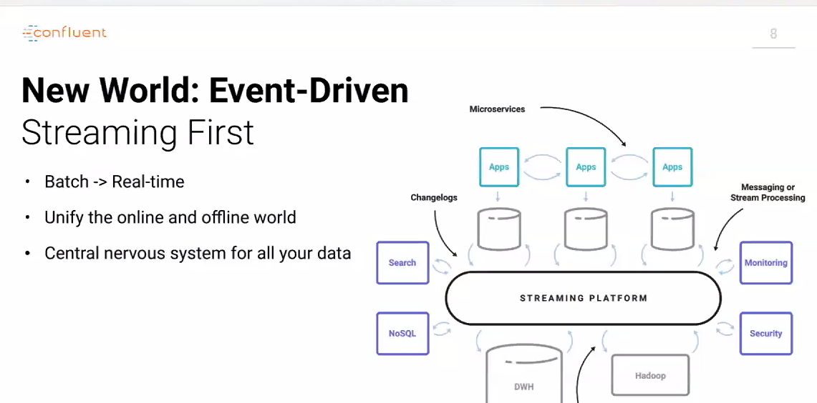

Slide 26
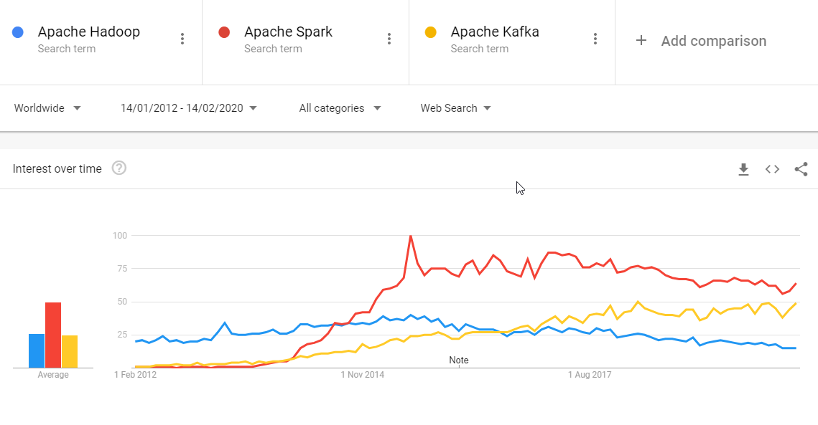
Notes:
https://trends.google.com/trends/explore?date=2012-01-14%202020-02-14&q=Apache%20Hadoop,Apache%20Spark,Apache%20Kafka

Slide 27
Cloud
Allowed to be conservative in investments.
Crawl before you walk and walk before you run.
Elasticity both for Storage and Processing.
Notes:
THE CLOUD IS BREAKING DOWN BARRIERS

Slide 28
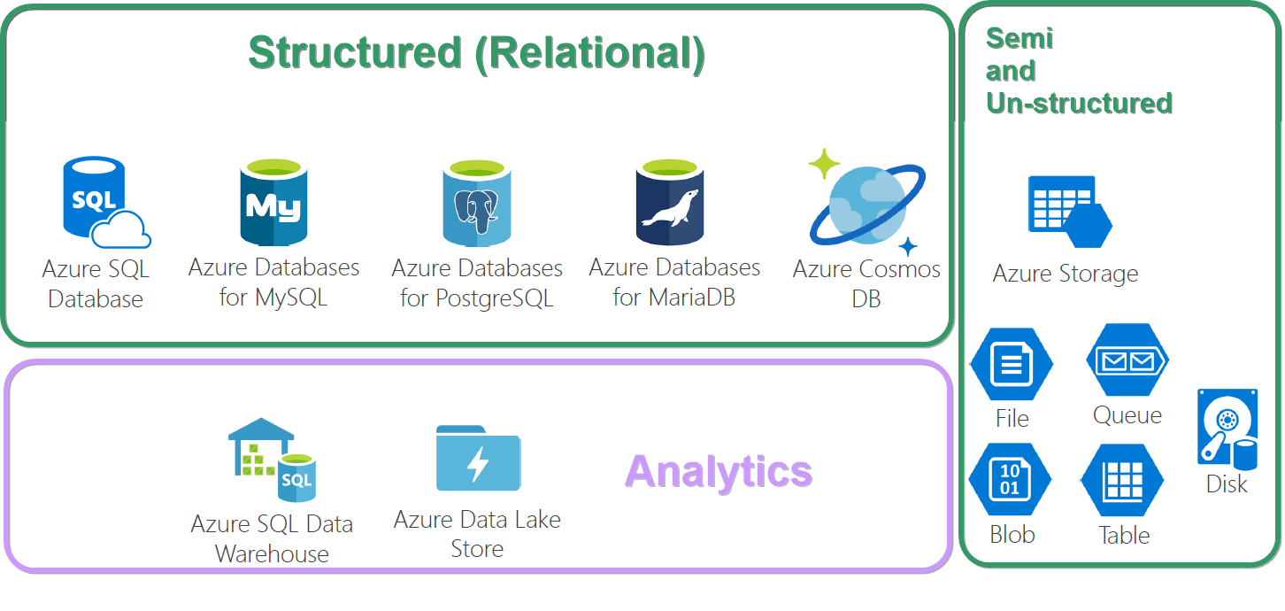
Database options in Azure

Slide 29
Services from the initial stages (2012) till now
Storage – HDFS –>Azure Data Lake...
Processing – Map Reduce –> Azure Kubernetes cluster, –> Azure Synapse Analytics, –> Azure Databricks...
Resources elasticity -> Create as you go via Automation scripts in PowerShell, Ansible.
Notes:
That too Azure Synapse Analytics take care of resource computation by itself “server as service”.

Slide 30
Azure Synapse Analytics
Simplifies your data lake and data warehousing solutions – Datalakehouse.
Reduces project development time for machine learning, BI, and AI.

Slide 31
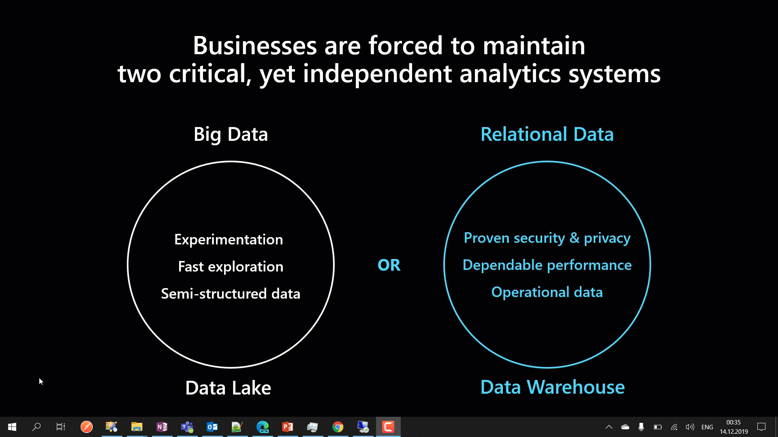
Notes:
Synapse Analytics combines Big Data and Relational Data to combine as one.

Slide 32
SQL Server Big Data Clusters

Slide 33
ML.Net
Open source cross-platform machine learning framework.
Custom ML made like a play with AutoML – GUI.
Not required much expertise in ML.

Slide 34
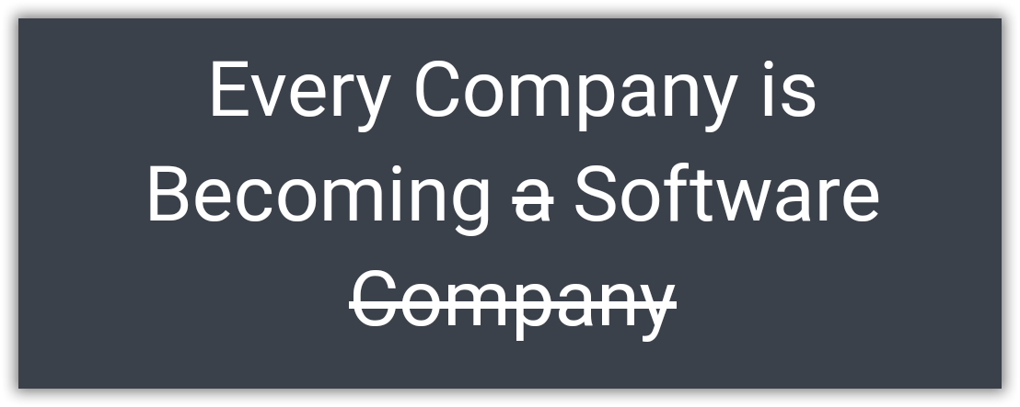
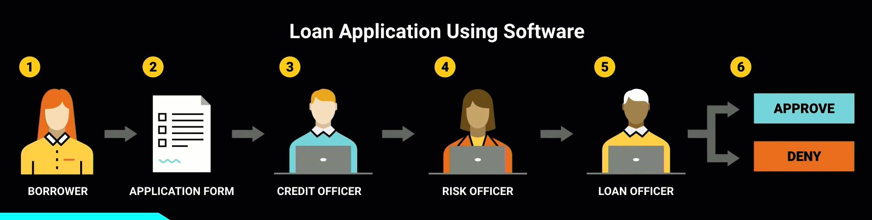
Borrowed from - https://www.youtube.com/watch?v=4QoCbhsQeyE
Notes:
Nowadays, a bank itself is software and takes the decision. Same case earlier humans took decisions using that software. A perfect example would be of sanctioning a personal loan. Things like the CIBIL score, a person’s authenticity available as up-to-date data has provided the power to decide to sanction a loan to machines themselves. Earlier, 1 or more bank employees should do the entire work of analyzing all these.
Finally I would like to end with this quote from Confluent.IO. “Every Company is Becoming software, which were previously just Using the software.”

Slide 35
Notes:
Again. Integration challenges, ranging from varied data formats and storage requirements to time-consuming, manual data exports and imports.ata project or any projects that ends with delivering something for decision making.
The challenges wont get reduced. But on the go, you will be more efficient in asking questions and deciding right set of tools.

Slide 36
Thank you! Q & A

